Slide 1

A 21st century industrialist
<Data Mining Project>
Amit Englstein
&
Charlotte Abitbol
Notes:
- The data source you decided to scrape from - The data you scraped - Some numbers of how much data you scraped - Database structure and why did you structure it this way - The data enriching source and what you were able to get from there - Challenges you experienced and how you faced them - a short demo of the visualisation - Insights or conclusions

Slide 2
Executive summary
1
Scraping data on Glassdoor
2
Enriching the data
3
Designing a job search database
4
Data visualization
5
Challenges we faced

Slide 3
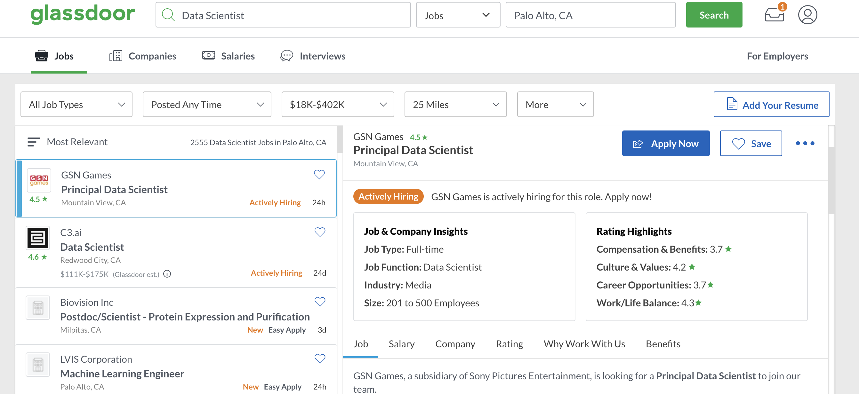
1. Scraping data on Glassdoor
Personalizing the search with filters on :
Job
Location
Number of jobs
Rating threshold
Notes:
Scraping data on

Slide 4
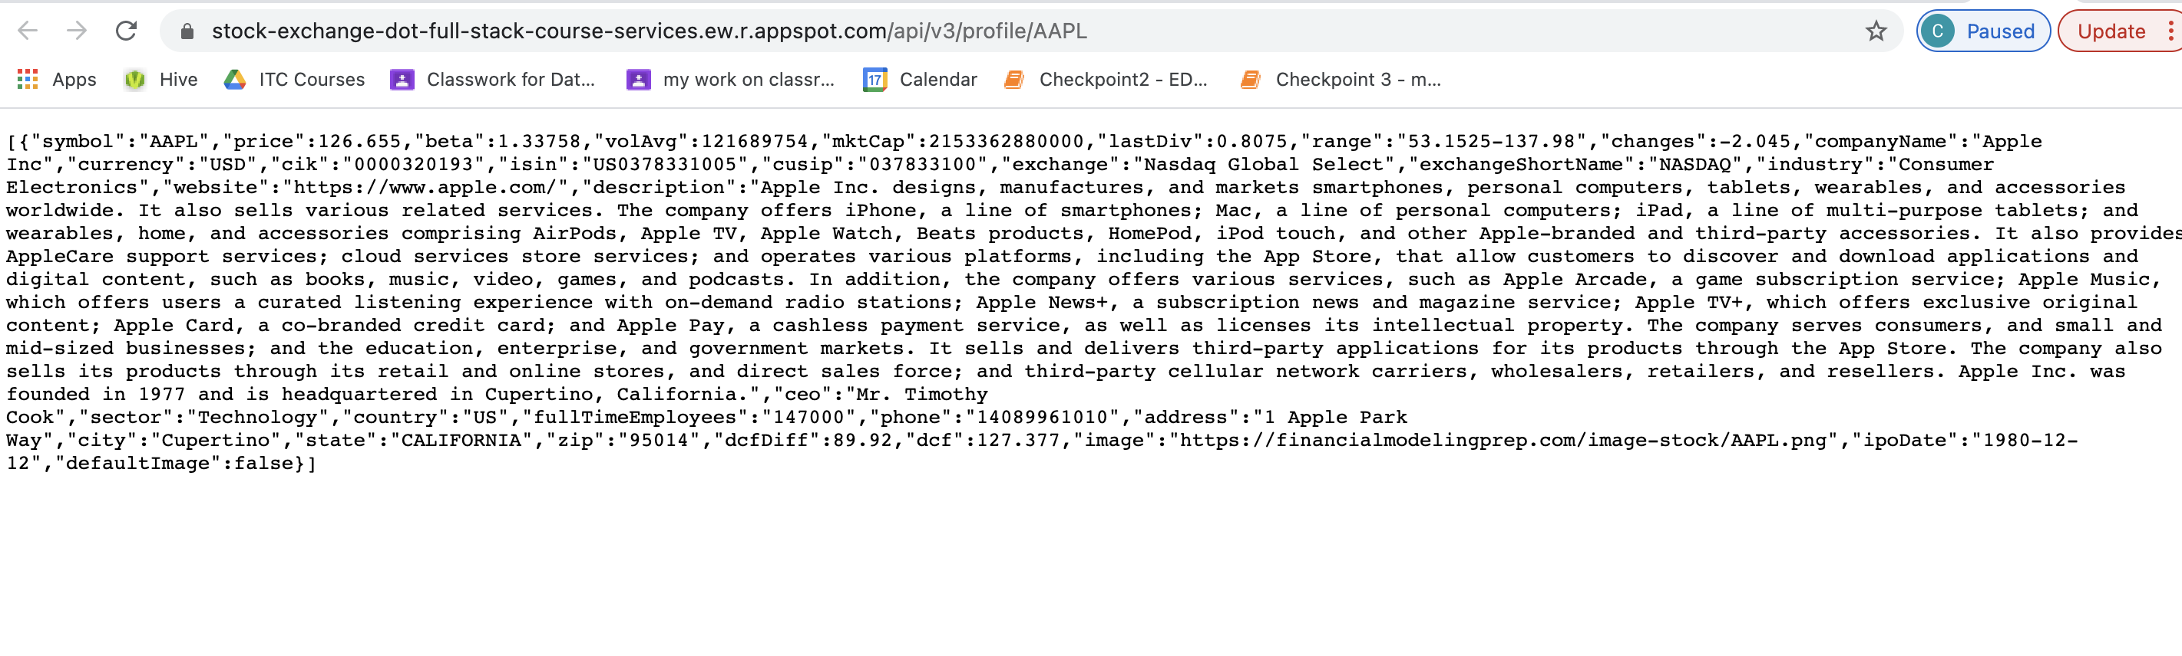
2. Enriching the company’s information
API : Stock market information
Stock price
Market capitalization
Currency
Company’s website
Exchange
Market
Notes:
Challenge :
Collecting the symbol in order to match the company’s name

Slide 5
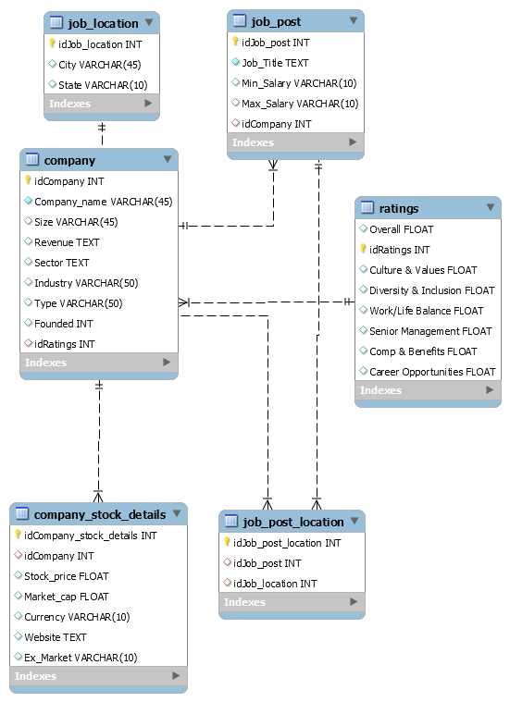
3. Designing a job search database
Notes:
6 tables
Pretty straightforward for us because we didn t have many tables so we just needed to think about the relationships
Many to many : between job location and job post
Company stock details : from the API

Slide 6
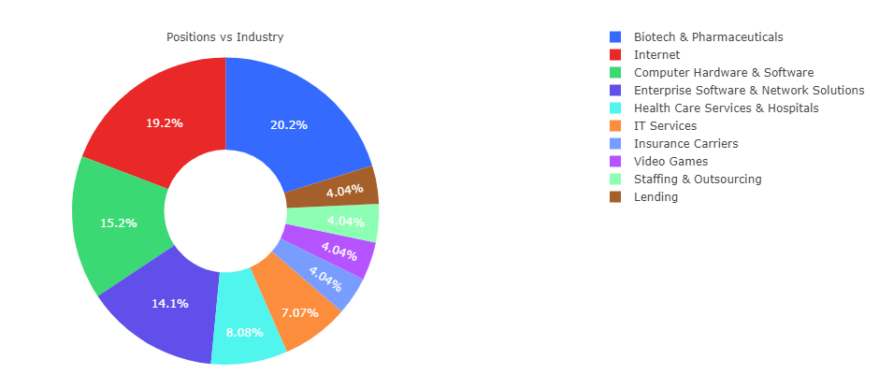
4. Data visualization
Top 10 industries that hire data scientists in San Francisco
Notes:
150 jobs scraped (in San francisco)
From the data we scraped, biotech and pharmaceuticals seemto be the sector that hire most right now, probably because of covid

Slide 7
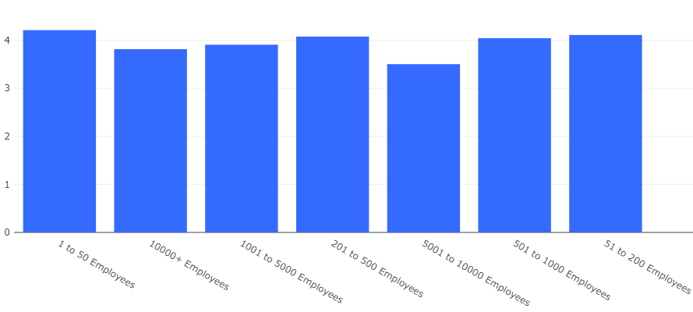
4. Data visualization
In San Francisco, the rating of a company does not seem correlated to its size
Average rating
Notes:
125 companies out of 150 total companies scraped
Average rating is high in all those scraped companies

Slide 8
5. Main challenges we faced
Time
Scraping
Understanding the basic html syntax
Interacting with the web server
Building the ratings dictionary dynamically
Deploying
Dealing with Chromedriver
Enriching
Process : Finding a public API in job search (public key no longer available)
Our API : Matching the symbol and the company’s name
Designing
Complexity
Notes:
We faced 4 types of challenges over the 4 big steps :
Quick to solve/low complexity : enriching the data
High time / low complexity
High time/high complexity
Low time/high complexity
The scraper and the deployment were the most time consuming for us

Slide 9
Thank you !

